Slide 1
Comparing Classifiers
Notes:
Fall 2004
CS478 - Machine Learning

Slide 2
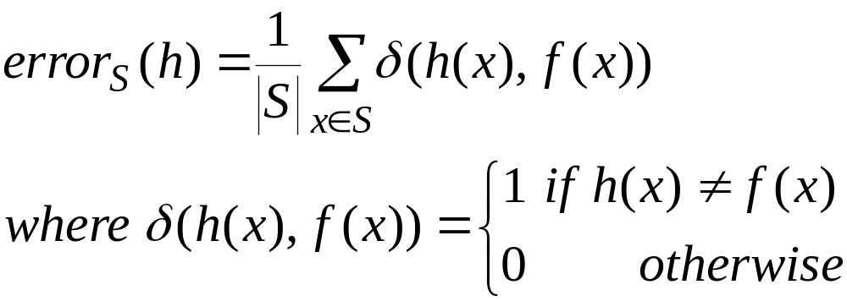
Sample Error
Error of hypothesis h with respect to function f and sample S

Slide 3
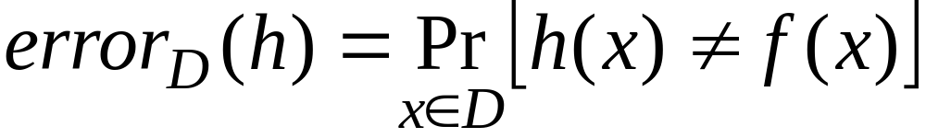
True Error
Error of hypothesis h with respect to function f and distribution D

Slide 4
The Question
We wish to know error_{D}(h)
We can only measure error_{S}(h)
How good an estimate of error_{D}(h) is provided by error_{S}(h)?

Slide 5
Confidence Interval
If h is a discrete-valued hypothesis, |S|=n≥30, and examples are drawn independently of h and one another, then with N% probability:
Confidence level N% | 50% | 68% | 80% | 90% | 95% | 98% | 99%
Constant z_{N} | 0.67 | 1.00 | 1.28 | 1.64 | 1.96 | 2.33 | 2.58

Slide 6
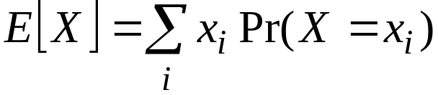
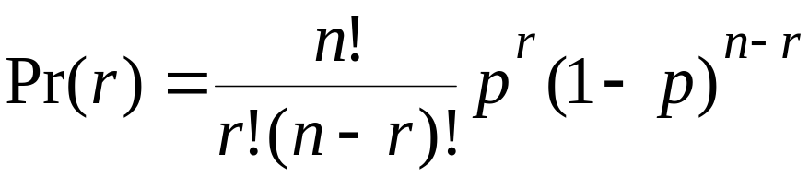
A Few Useful Facts (I)
The expected value of a random variable X, also know as the mean, is defined by:
The Binomial distribution gives the probability of observing r heads in a series of n independent coin tosses, if the probability of heads in a single toss is p

Slide 7
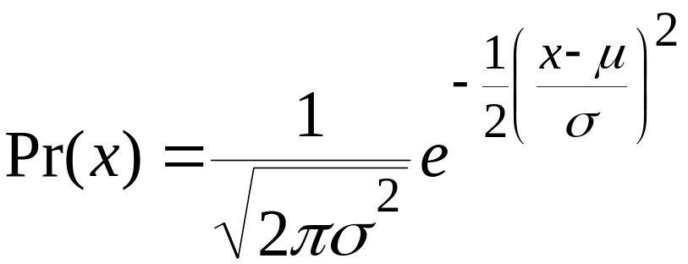
A Few Useful Facts (II)
The Normal distribution is the well-known bell-shaped distribution, arising often in nature:
Expected values:

Slide 8
A Few Useful Facts (III)
Estimating p from a random sample of coin tosses is equivalent to estimating error_{D}(h) from testing h on a random sample from D:
  Single coin toss ≡ Single instance drawing
  Probability p that a single coin toss is head ≡ probability that single instance is misclassified
  Number r of heads observed over a sample of n coin tosses ≡ number of misclassifications observed over n randomly drawn instances
Hence, we have:
  p = error_{D}(h)
  r/n = error_{S}(h)

Slide 9
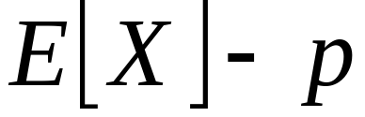
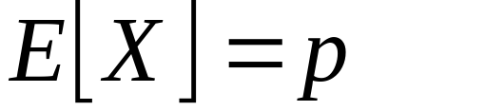
A Few Useful Facts (IV)
An random variable can be viewed as the name of en experiment whose outcome is probabilistic
An estimator is a random variable X used to estimate some parameter p (e.g., the mean) of an underlying population
The bias of an estimator X is defined by:
An estimator X is unbiased if and only if:

Slide 10
A Few Useful Facts (V)
Since, we have:
  p = error_{D}(h)
  r/n = error_{S}(h)
  E[X_{Binomial}] = np
It follows that:
  E[error_{S}(h)] = E[r/n] = E[r]/n = np/n = p = error_{D}(h)
Hence, error_{S}(h) is an unbiased estimator of error_{D}(h)

Slide 11
Comparing Hypotheses
We wish to estimate error_{D}(h₁) - error_{D}(h₂)
We measure error_{S1}(h₁) – error_{S2}(h₂), which turns out to be an unbiased estimator
In practice, it is OK to measure on the same test set error_{S}(h₁) – error_{S}(h₂), which has lower variance

Slide 12
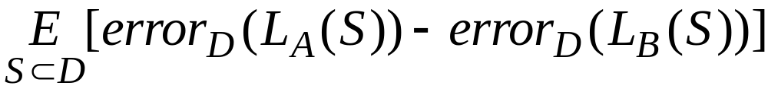
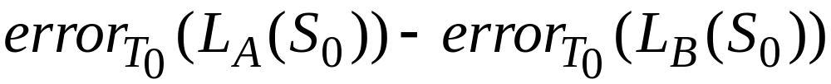
Comparing Classifiers (I)
We wish to estimate
In practice, we have a sample Do: Split into train/test sets and measure:

Slide 13
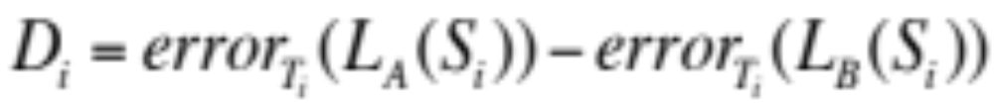
Comparing Classifiers (II)
Problems:
  We use error_{T0}(h) to estimate error_{D}(h)
  We measure the difference on S0 alone (not the expected value over all samples)
Improvement:
  Repeatedly partition dataset D_{i} into N disjoint train (S_{i})/test (T_{i}) sets (e.g., using n-fold Xval)
  Compute:

Slide 14
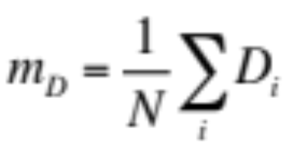
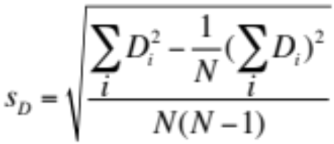
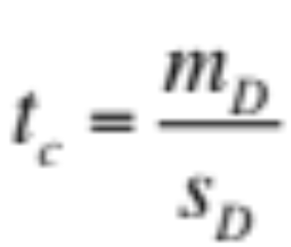
Comparing Classifiers (III)
Derive:
t is known as the student-t statistic.
  Choose a significance level q
  With N-1 degrees of freedom, if t_{c} exceeds the value in the table then the difference is statistically significant

